Slide 1

US Public Transportation Analysis
Financial, Operational, Environmental Aspects
PROJECT OVERVIEW
Team: Tyga Numata, Azizha Zeinita, Akhir Syabani
PROJECT OVERVIEW
Business Case
Tools and Process
Data Model
Lessons Learned
Recommendation

Slide 2
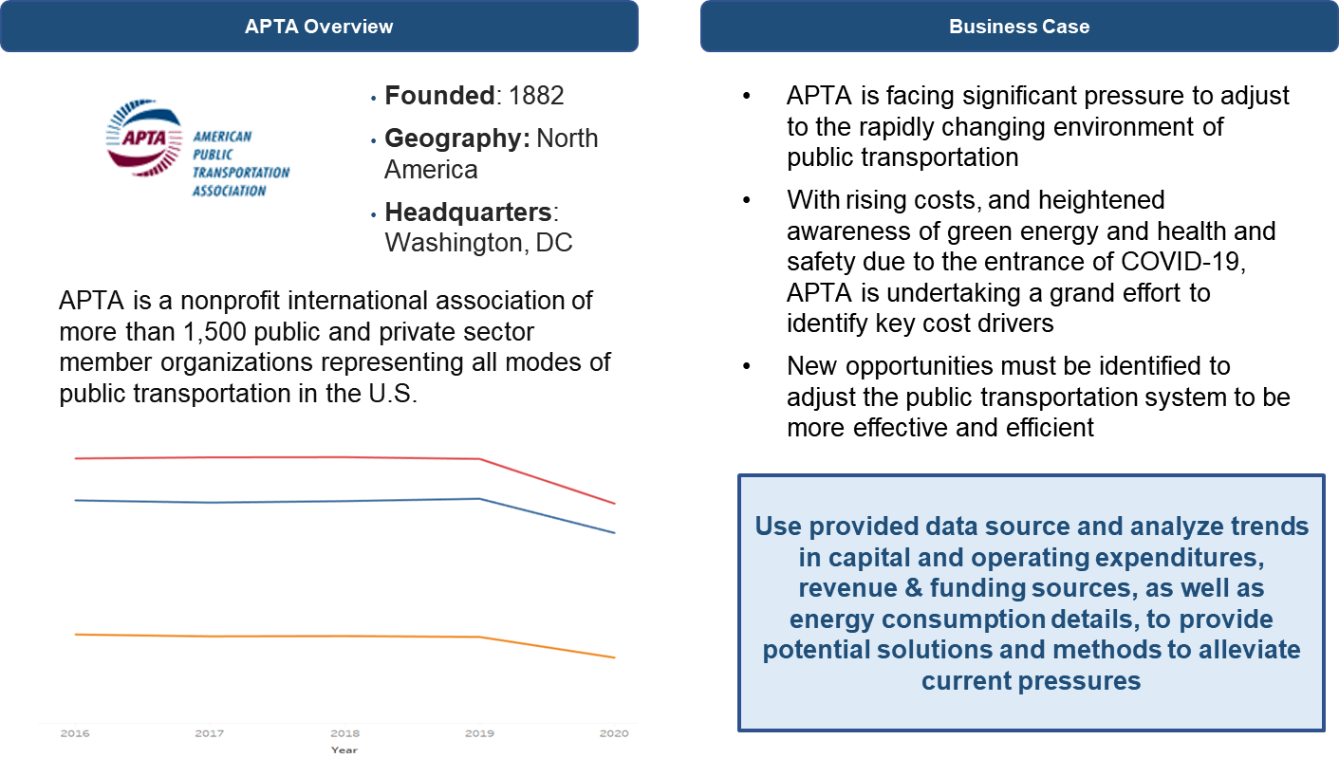
BUSINESS CASE: APTA
Notes:
So to kick us off, I will briefly explain the purpose of the business case which entails the American Public Transportation Association which is responsible for the public transportation of more than 1500 public and private sector member organizations in the United States.
as you can see from the bottom left chart, the use of public trasnportaiton has remained fairly stagnant, with an evidently large dip during last year’s anomaly of a pandemic year. Overall, APTa has been facing significant pressure to adjust to the rapidly changing expectations of public transportation and the purpose of our project was to manipulate and analyze the data to provide tailored solutions to alleviate current external pressures.

Slide 3





TOOLS & HIGH-LEVEL PROCESS
K-12
ETL
K-12
Visualization
Extract
Data Gathering
Discover and Assess Dataset
Transform
Normalization
Data Cleaning
Load
Creating DDL
Convert the CSV files to SQL scripts (DML)
Load DML to DDL
Connected to MySQL + additional data
Tableau Worksheet -> Dashboard -> Story
Divide sections:
General Overview
Financial
Operational
Environmental
Others
Recommendations

Slide 4
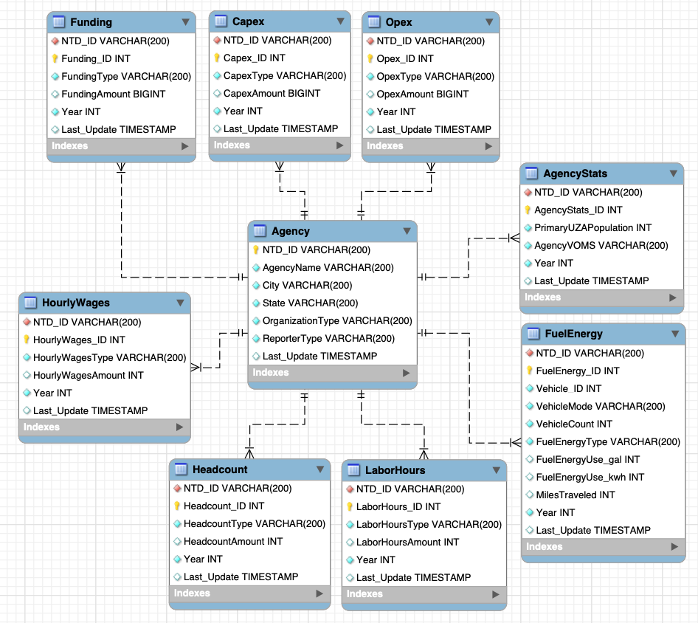
DATA MODEL
Relational Database
5 Selected Data Categories (Excel to CSV)
5-year data = 5x5 = 25 files
9 Normalized Tables
Agency
AgencyStats
Funding
Capex
Opex
Headcount
HourlyWages
LaborHours
FuelEnergy

Slide 5
LESSONS LEARNED & RECOMMENDATION
Lessons Learned
Even when the tools are compatible for all operating systems (OS), unique/specific problem may still arise for each OS
Difficulty in importing data directly from CSV to MySQL, with regards to capacity and file conversion format
Source-to-target mapping requires significant time for completion
Due to time constraints, we need to adjust the approach outside the normal process to incorporate more required data
Recommendation
Ensuring the usability across operating system is crucial before moving forward with the tools and methods
For data input to MySQL, better to convert the source CSV files to SQL scripts
Allocate sufficient time for table transformation (source-to-target mapping) during ETL
It is possible to use additional approach/workaround to add more information

